Slide 1

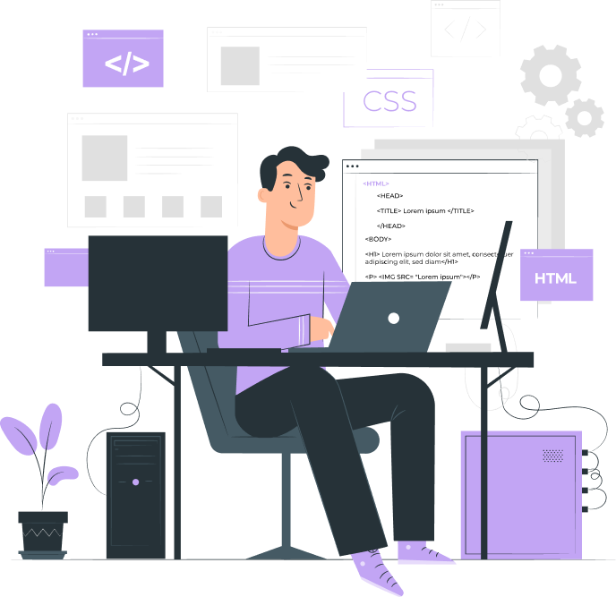
Introduction to Media Queries

Slide 2

Topics
What is the media query in CSS?
Anatomy of a Media Query
Do we really need media queries?

Slide 3
What is the media query in CSS?
Media queries in CSS allow you to define different styles for different device types, screen sizes, and orientations. This is particularly useful for creating responsive web designs that adapt to different devices and screen sizes.

Slide 4
Anatomy of a Media Query

Slide 5
Media:
The @media rule is the starting point for defining media queries in CSS. It is used to define a block of styles that should only be applied under certain conditions (i.e. based on media query conditions).
@media [media-type] ([media-feature]) {
/* Styles! */
}

Slide 6
Media type:
The media type is a keyword that specifies the type of device or media being targeted.
All
Screen
Print
Speech
@media screen and (max-width: 600px) {
/* Styles for screens with a maximum width of 600px */
}

Slide 7
Media feature:
A media feature is used to test specific characteristics of the device or viewport, such as width, height, orientation, and resolution.
Height
Width
Orientation
Aspect-ratio
Resolution
Color
Hover
print

Slide 8
Operators
Logical operators such as and, or, and not can be used to combine multiple media features or media types to create more complex conditions for when styles should be applied.
“and”:
// Matches screen between 320px AND 768px
@media screen (min-width: 320px) and (max-width: 768px) {
.element {
/* Styles! */
}
}
“not” :
@media print and ( not(color) ) {
body {
background-color: none;
}
}
“or” :
//matches screens where either the user prefers dark mode or the screen is at least 1200px wide
@media screen (prefers-color-scheme: dark), (min-width 1200px) {
.element {
/* Styles! */
}
}

Slide 9
Do we really need media queries?
Media queries are an essential part of creating a responsive web design that can adapt to different screen sizes and devices.
Change the layout of a page from a multi-column format to a single-column format on smaller screens
Adjust the font size and line spacing to make the text easier to read on smaller screens.
Hide or show certain elements, such as navigation menus or sidebars, depending on the screen size.

Slide 10
THANK YOU

